Slide 1
Analyze neighborhoods in Houston to start a private school
Saranya Kamalasekaran

Slide 2
Evaluating neighborhood to build new private school
Most private school businesses rely on these factors for their success--customers, employees.
Locating private school where these groups can be reached easily, is vital.
The proximity of competitors is important.
Using advanced Machine learning technology, analyzing neighborhoods in large metropolis city.

Slide 3

Data acquisition and cleaning
List of Houston Neighborhoods is extracted from https://en.wikipedia.org/wiki/List_of_Houston_neighborhoods
The private school dataset used in this project is obtained from Kaggle, originally obtained from the US Department of Homeland Security. https://www.kaggle.com/andrewmvd/us-schools-dataset
List of Houston county dataset is used to filter private school dataset pertaining to Houston.
The geographical location required for this project is obtained from Foursquare API.

Slide 4

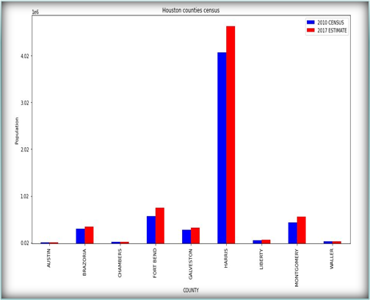
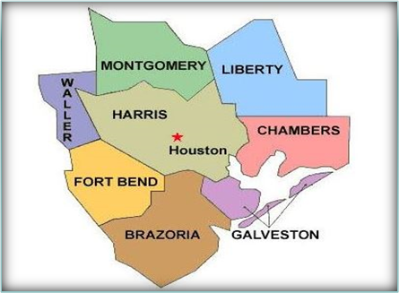

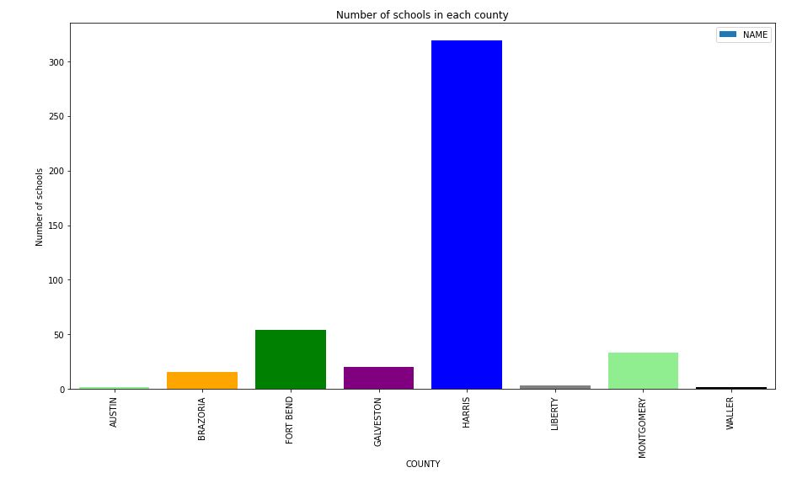
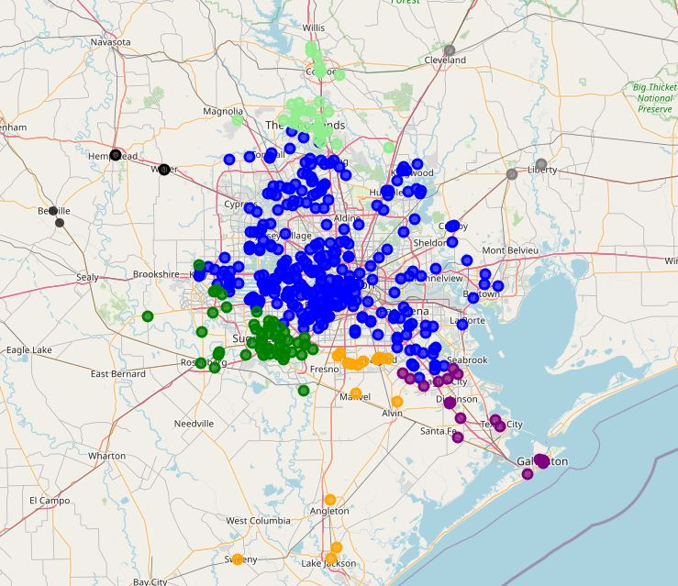
Distribution of private school
z
Brazoria, Fort Bend, Harris and Montgomery county has significant increase in its population and schools.
Schools are widely spread on the north-east part of Houston.

Slide 5
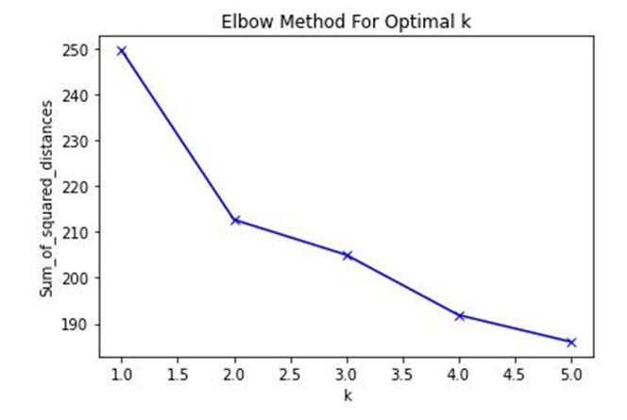
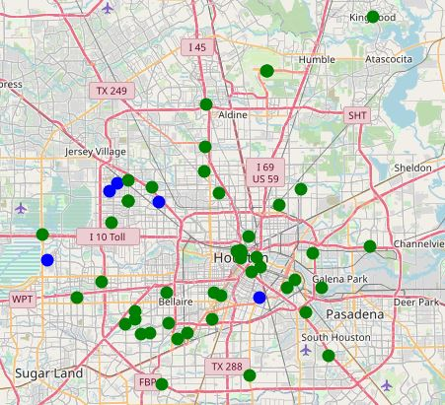
K-means clustering model
To obtain optimal result, first we find the number of clusters (k value).
As k increases, the sum of squared distance tends to zero.
If the plot looks like an arm, then the elbow on the arm is optimal k which is equal to 2.
Using Folium, the 2 clustered neighborhoods are displayed.
z

Slide 6
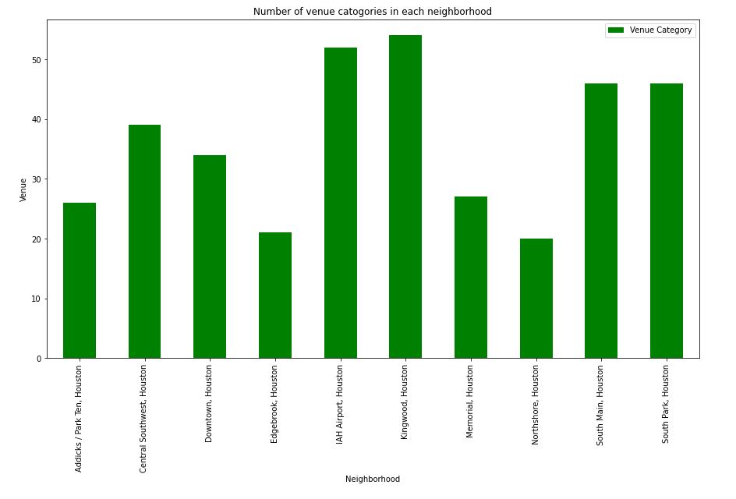
We pick Kingwood as our area of interest to build the new private school.
Conclusion and future directions
Useful models can be built to further analyze neighborhoods based on the average income and race of the population.
Accuracy can be improved by including sub-neighborhoods data.
Recommended zones should therefore be considered only as a starting point for more detailed analysis which could eventually result in location which has not only no nearby competition, but also other factors considered, and all relevant conditions met.
z

